Slide 1
Chapter 2: High-Level Languages
Java
Notes:
This presentation is on Java which most of you are familiar with because it is the language taught in the Computer Science classes at UIS.
This describes how Java compares to other compiled languages. It would be best to listen to the presentation on Programming Languages before reviewing this one.

Slide 2
Java: Compiled & Interpreted
Java programs (classes) execute within the Java Virtual Machine (JVM).
Java can run on any platform with a virtual machine environment
Java is both compiled and an interpreted
Output of the compiler is an assembly-like intermediate code (bytecode)
Bytecode is interpreted by the JVM
Notes:
*
The Java programming language uses many of the tools that are discussed in the Programming Tools Lecture.
Java programs (classes) execute within a virtual machine, the Java Virtual Machine (JVM).
This allows the language to run on any platform for which a virtual machine environment has been written.
Java is both a compiled and an interpreted language.
The output of the compilation process is an assembly-like intermediate code (bytecode) that is interpreted by the JVM.

Slide 3
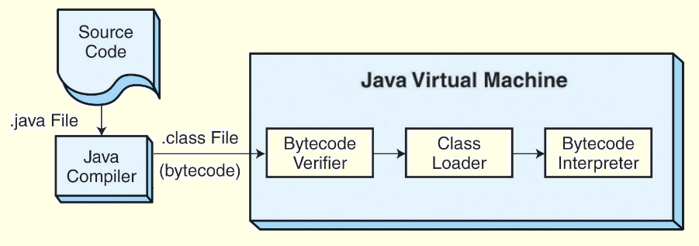
Java: Compiled & Interpreted
JVM is a miniature operating
Loads programs
Links them
Manages program resources
Deallocates resources at program termination
JVM performance cannot match that of a traditional compiled language
Notes:
*
The JVM is an operating system in miniature
It loads programs, links them, starts execution threads, manages program resources, and deallocates resources when the programs terminate.
Because the JVM performs so many tasks at run time, its performance cannot match the performance of a traditional compiled language.
Remember this is 1 of three lectures for Chapter 2. Please listen to all of them before doing the quiz.

